Slide 1


Advanced Prototype
Catch Your Money

Slide 2


AGENDA
Changes in Requirements
Changes in Structure of the App
Design Pattern
Coding Conventions
Context of Use
UI Design
Marcel Öfele

Slide 3

CHANGES IN REQUIREMENTS
As a user
I want to be able to also delete transactions to adjust mistakes
New Requirements and User Stories
As a user
I want a report of my past transactions with charts
Adding two charts to the report screen
Adding Icons for categories
Adding option to delete the transaction
Budget planning for a month
Monthly summary of transactions via e-mail
As a user
I want to be able to set a budget for a month to plan ahead
As a user
I want to be able to assign icons to my newly defined categories
As a user
I want to get a monthly report via e-mail to always stay informed
Marcel Öfele

Slide 4
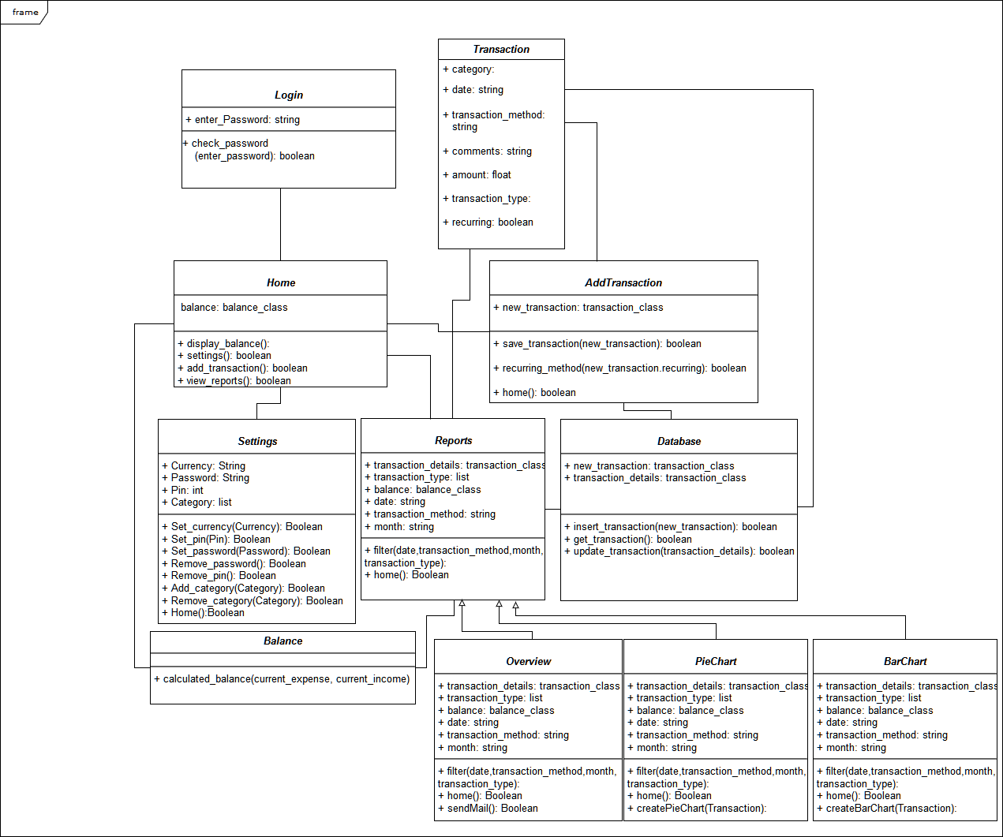
CHANGES IN STRUCTURE
Marcel Öfele

Slide 5
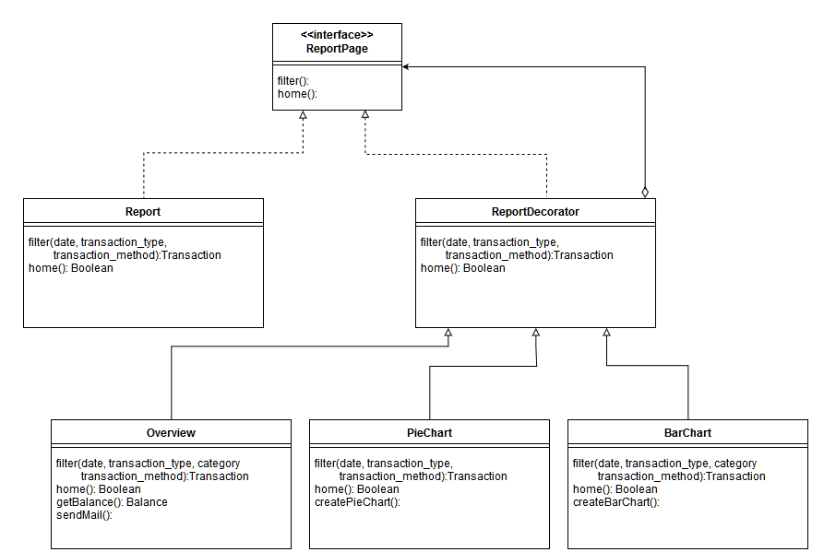
DESIGN PATTERN
Decorator for Report Pages
Marcel Öfele

Slide 6
CODING CONVENTIONS
Follow JavaSoft conventions:
Class: Noun, first letter capitalized
Method: starts with a verb, lower case
Variables: descriptive names, lower case
Constants: like variables but capitalized
Internal conventions:
using the same abbreviations (especially for widgets)
(e.g. TextView for category: tvCategory, Spinner for transaction type: spinType)
using same vocabulary (Login: Authentication, Transaction Type: Type)
Comments, Comments, Comments!
Enforcing conventions by team review of the code
Marcel Öfele

Slide 7


CONTEXT OF USE
Personas
Saira, 23, international student at FIN
Education: B.Sc. in Computer Science
Technical Background:
strong interest in technological gadgets
wants to personalize her applications
is used to a lot of adjustable options in apps
Goals:
keeping track of her tight budget
having fun with the statistical reports
playing around with the options
Jan, 27, working on his PhD in Psychology
Education: M.Sc. in Psychology
Technical Background:
weak interest in technology
is only interested in the functionality of apps
Goal:
keeping track of his tight budget
Marcel Öfele

Slide 8
UI DESIGN
Design Principles and Color Scheme
Design Principles
Usability: Design should never hinder the functionality
Understandability: Easy to use and follow
Minimalistic: No unnecessary design elements, focus on the function
Color Scheme
Green accents: association with stability, wealth, growth; slightly relaxing
White background: supporting minimalistic design and clean look
Marcel Öfele

Slide 9
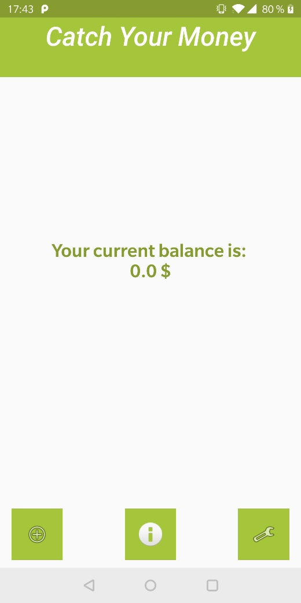
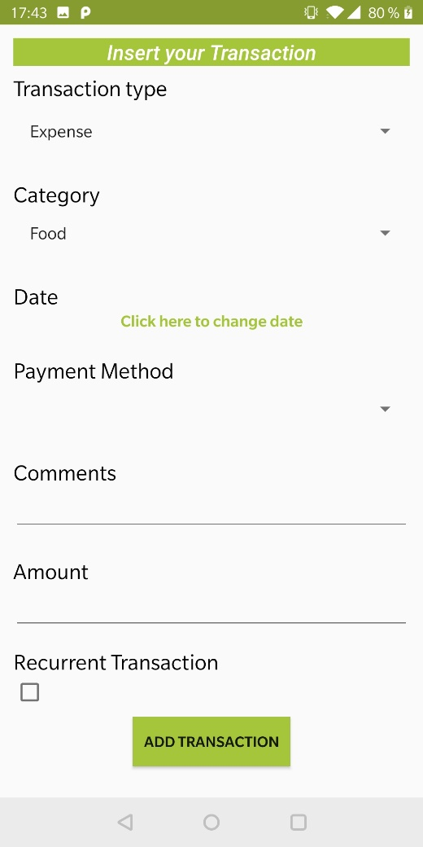
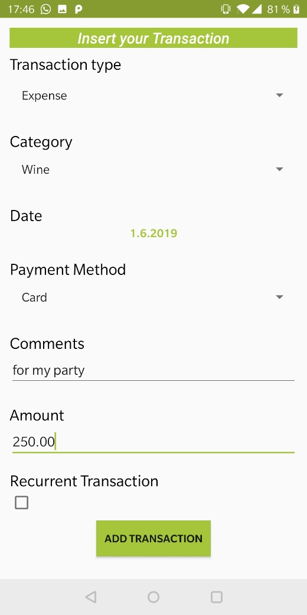
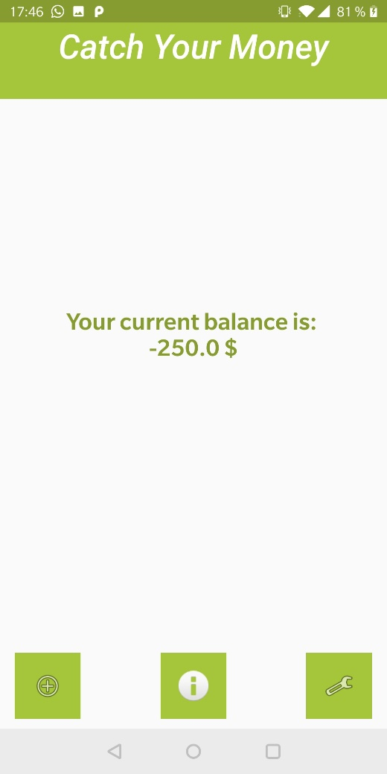
UI DESIGN
Storyboard 1: Adding New Transaction
Marcel Öfele

Slide 10
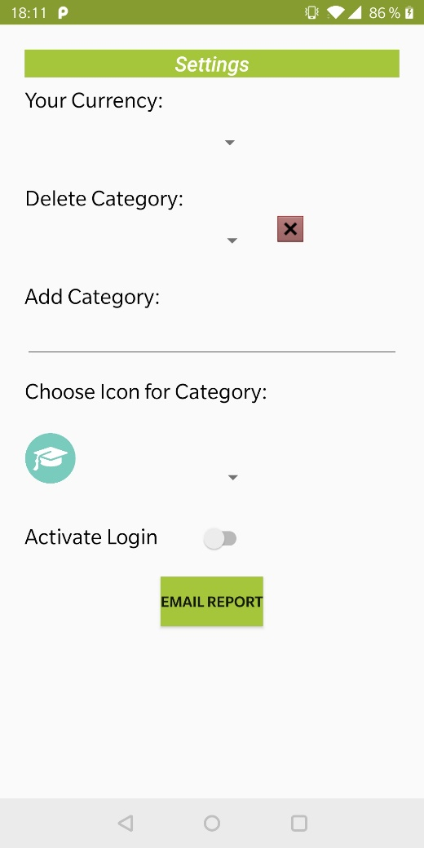
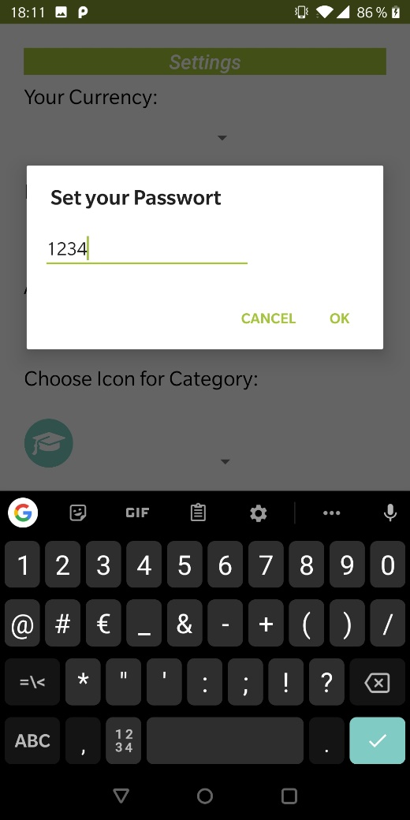

UI DESIGN
Storyboard 2: Activating Login
Closing and Restart
Marcel Öfele

Slide 11
Thank you for your attention

Slide 12

CHANGES IN REQUIREMENTS
Changes in User Stories
As a user
I want a report of my past transactions with filters
As a user
I want to be able to create my own categories for every transaction
As a user
I want to input my expenses/income to track them
As a user
I want a report of my past transactions with charts
As a user
I want to be able to assign icons to my newly defined categories
As a user
I want to be able to also delete transactions to adjust mistakes
Marcel Öfele

Slide 13
CHANGES IN REQUIREMENTS
New User Stories
As a user
I want to be able to set a budget for a month to plan ahead.
As a user
I want to get a monthly report via e-mail to always stay informed
Marcel Öfele

